Slide 1
Stack Movement Predictive parser LL(1)
Course Code: CSC3220
Course Title: Compiler Design
Dept. of Computer Science
Faculty of Science and Technology
Lecture No: | 11 | Week No: | 11 | Semester: | Fall 2023-2024
Lecturer: | Shahnaj Parvin, sparvin@aiub.edu

Slide 2
Lecture Outline
First, Follow and Parsing Table Exercise and Practice
Non-Recursive predictive parsing
Stack Movement of Predictive parser

Slide 3
Objective and Outcome
Objective:
To review predictive parsing table construction with example
To elaborate the necessity of stack movement by a predictive parser
To explain non-recursive predictive parsing algorithm
Demonstrate stack movement of a predictive parser for a certain input with example
Outcome:
The student will improve their ability of FIRST, FOLLOW and parsing table construction skills.
After this class the students will understand non-recursive predictive parsing algorithm
The students will be capable of demonstrating stack movement of a predictive parser for a certain given input string from given Grammar (CFG)

Slide 4
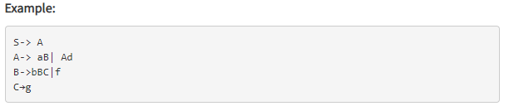
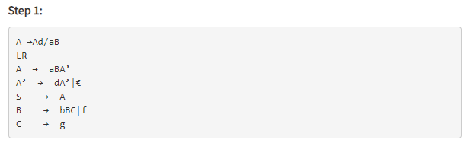
Predictive parsing table for the grammar (Example)

Slide 5
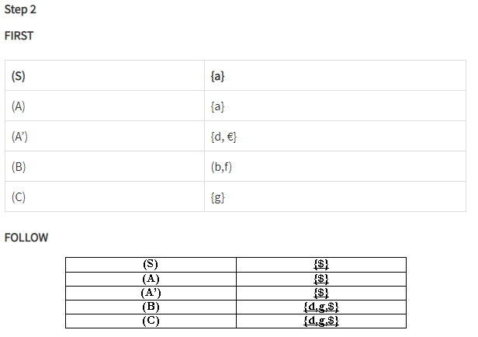
Predictive parsing table for the grammar (Example)

Slide 6
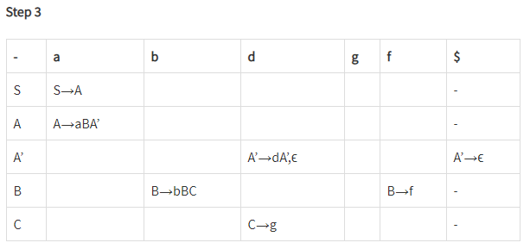
Predictive parsing table for the grammar (Example)

Slide 7
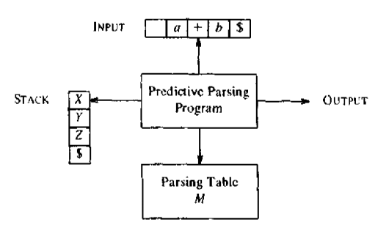
Non Recursive Predictive Parsing
Algorithm
It is possible to build a non recursive predictive parser by maintaining a stack.
The key problem during predictive parsing is that determining the production to be applied for a nonterminal.
The non recursive parser looks up the production to be applied in the parsing table.

Slide 8
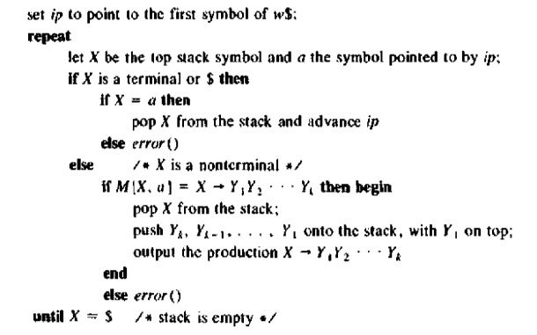
Non Recursive Predictive Parser
Algorithm
Input: A String (input) w, a parsing table M and a grammar G
Output: If w is in L(G), a leftmost derivation of w; or error
Method: Initially, the parser is in a configuration in which it has $S on the stack with S, the start symbol of G on top, and w$ in the input buffer. The program that utilizes the predictive parsing table M to produce a parse for the input

Slide 9
Stack Movement
Non Recursive Predictive Parser Method
With the help of FIRST, FOLLOW and associated Parse Table predictive parser makes moves
With a certain input string the predictive parser makes the sequence of moves
The input pointer points to the leftmost symbol of the string in the input column
It is tracing out a leftmost derivation for the input, the productions output are those of a leftmost derivation
The input symbols that have already been scanned, followed by the grammar symbols on the stack (from top to bottom), make up the left-sentential forms in the derivation.

Slide 10
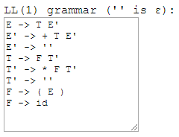
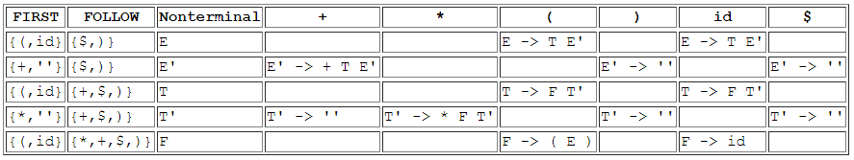
Parsing Table Construction (Example 1)

Slide 11
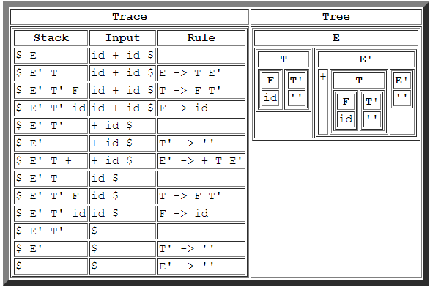
Stack Movement a Predictive Parser (Example 1)
Given input String: id + id

Slide 12
Show the moves for the input id + id * id
Link:
https://www.tutorialspoint.com/construct-a-predictive-parsing-table-for-the-following-grammar-and-also-check-whether-string-id-plus-id-id-is-accepted-or-not

Slide 13
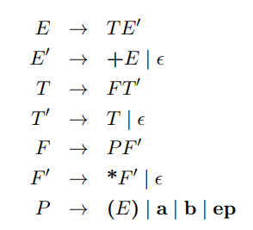
Parsing Table Construction (Example 2)
Consider the following LL(1) grammar, which has the set of terminals T = fa; b; ep; +; *; (; )g. This grammar generates regular expressions over fa, bg, with + meaning the RegExp OR operator, and ep meaning the ε symbol. (Yes, this is a context free grammar for generating regular expressions!)

Slide 14
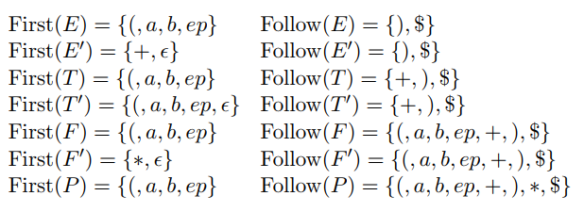
Parsing Table Construction (Example 2)
FIRST and FOLLOW sets

Slide 15
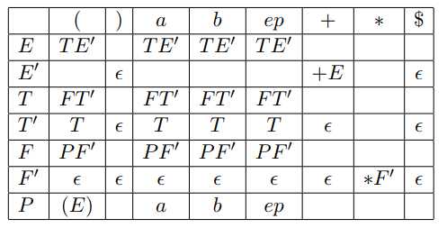
Parsing Table Construction (Example 2)
LL (1) Parsing Table

Slide 16
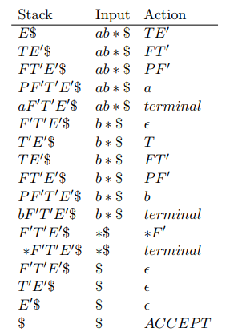
Parsing Table Construction (Example 2)
operation of an LL(1) parser on the input string ab*.

Slide 17
Parsing Table Construction (Exercise)
Construct a LL(1) parser for the following CFG. Show moves made by this LL(1) parser on the input
int * int + int
E → T X
X → + E | ε
T → int Y | ( E )
Y → * T | ε

Slide 18
Parsing Table Construction (Exercise)
Modify the following CFG so as to make it suitable for top-down parsing. Construct a LL(1) parser for the modified CFG. Show moves made by this LL(1) parser on the input (id + id). Another input id + (id).
S –> E
E –> T | E + T
T –> id | (E)

Slide 19
Lecture References
Compilers-Principles, techniques and tools (2nd Edition) V. Aho, Sethi and D. Ullman

Slide 20
References/ Books
1. Compilers-Principles, techniques and tools (2nd Edition) V. Aho, Sethi and D. Ullman
2. Principles of Compiler Design (2nd Revised Edition 2009) A. A. Puntambekar
3. Basics of Compiler Design Torben Mogensen

